Slide 1
Tragedy of the Commons
A look at another Systems Archetype

Slide 2
Definition
Individuals use a commonly available but limited resource solely on the basis of individual need. At first they are rewarded for using it; eventually, they get diminished returns, which causes them to intensify their efforts. Eventually, the resource is either significantly depleted, eroded, or entirely used up.

Slide 3
Early Warning Symptom
“There used to be plenty for everyone. Now things are getting tough. If I’m going to get any profit out of it this year, I’ll have to work harder,”

Slide 4
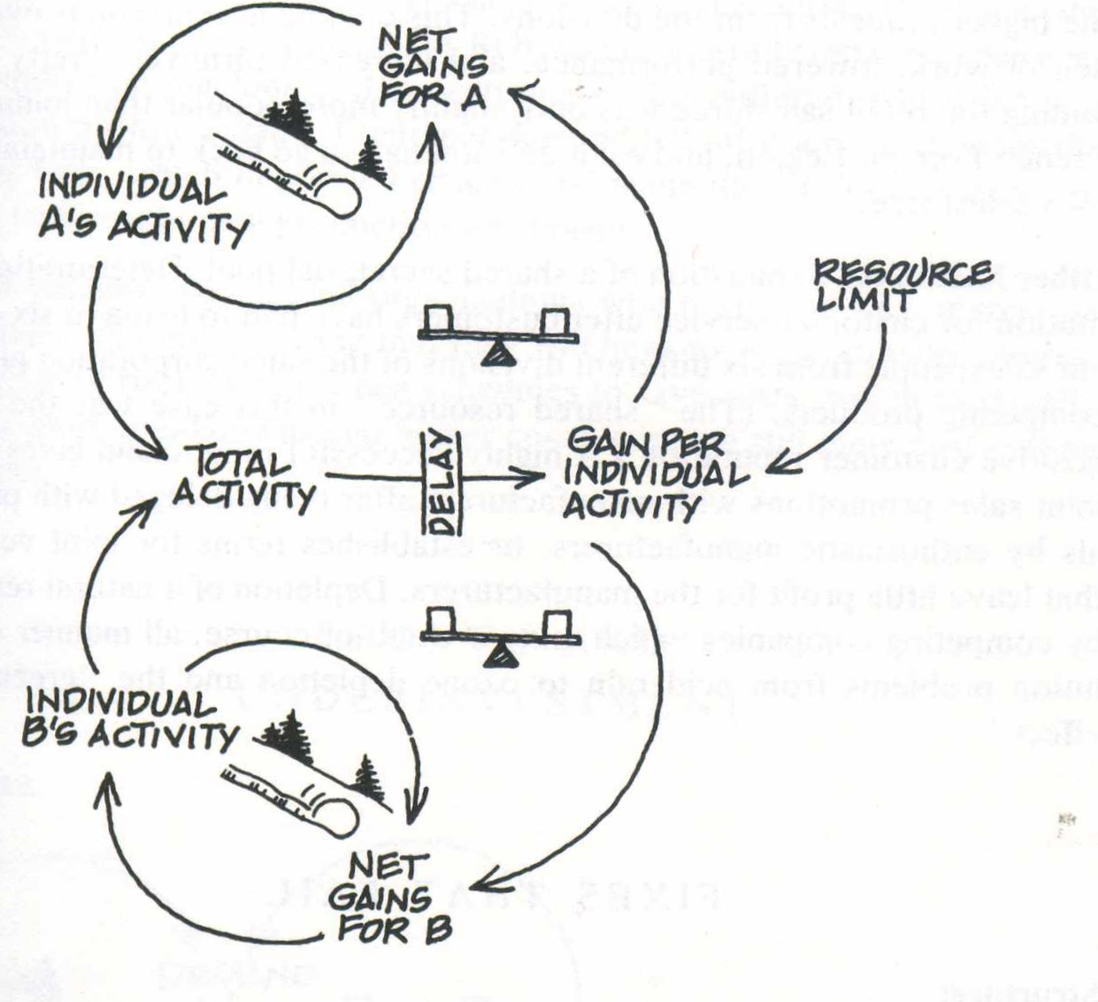
Structure
+
+
+
+
+
-
+
+
+

Slide 5
Commons of Interest
Land
Atmosphere
Oceans
Water
Stored Energy Sources
Minerals

Slide 6
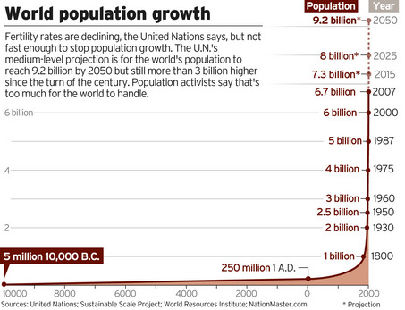
World Population

Slide 7
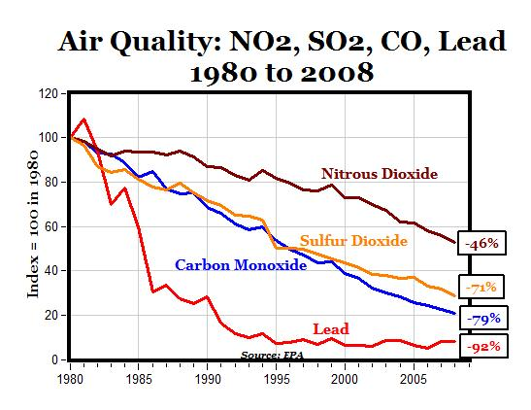
Air Pollution Graph

Slide 8
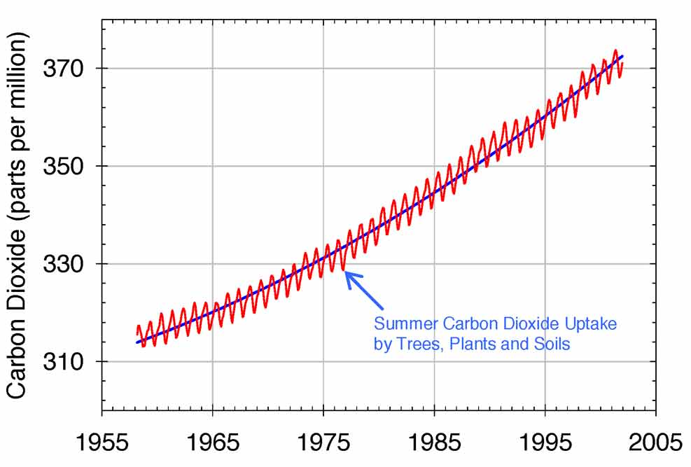
Carbon Dioxide Graph long term

Slide 9
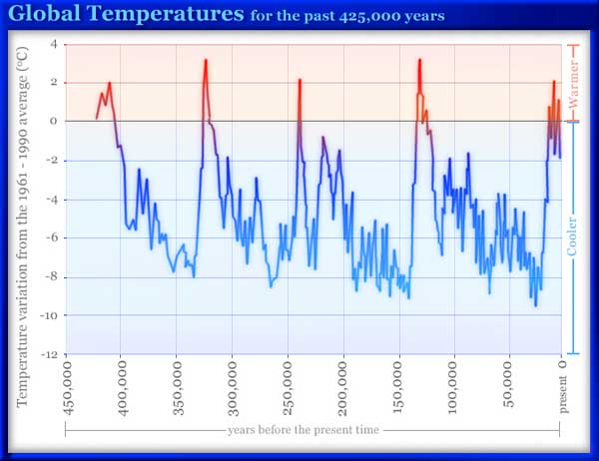
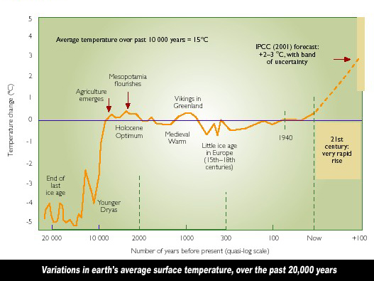
Global Temperatures

Slide 10
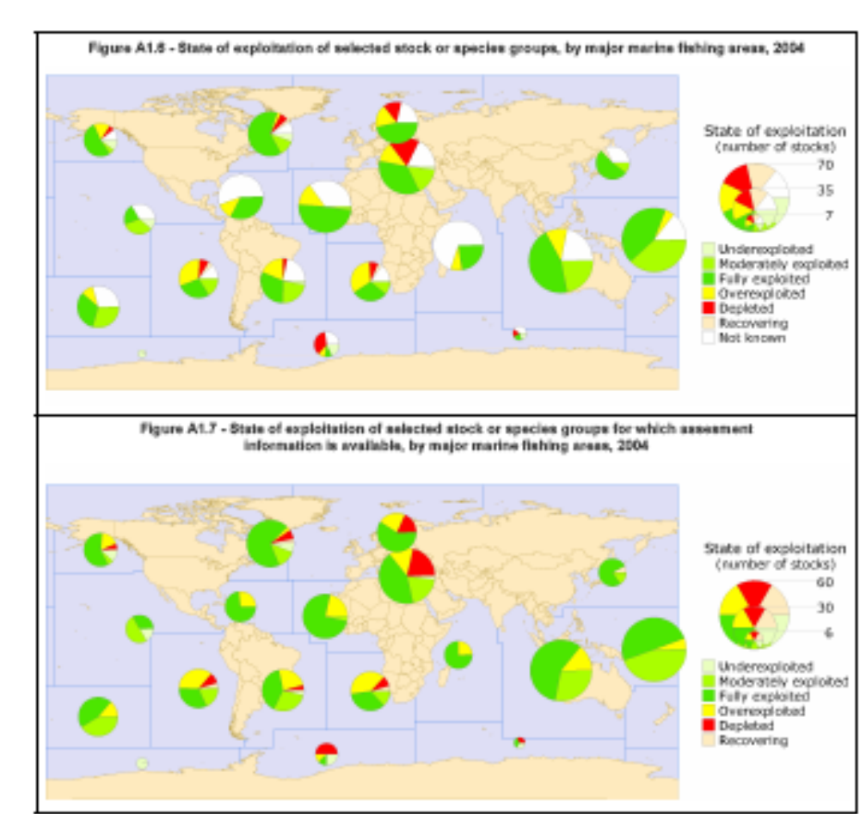
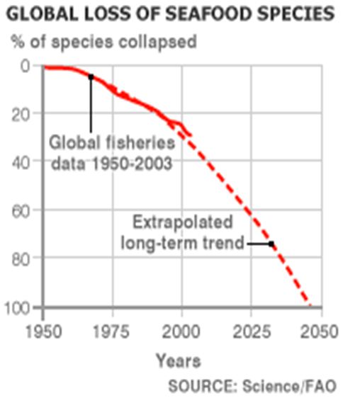
Marine Fisheries

Slide 11
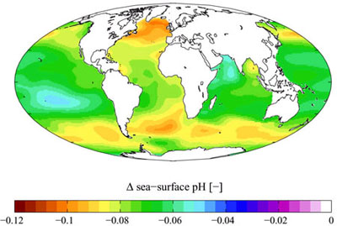
Ocean Acidification
Figure 1: Changes in Sea-Surface pH from Anthropogenic CO2 Emissions (pre-industrial to 1990s)
Note: Lower pH indicates greater acidity (see Box 1: Understanding the pH Scale)
Source: Pacific Science Association, 2007
http://earthtrends.wri.org/updates/node/245

Slide 12
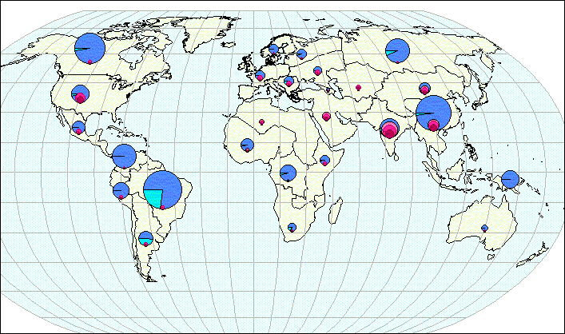
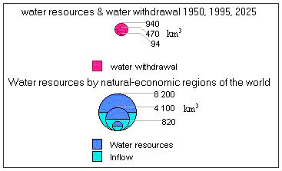
Water Resources
http://webworld.unesco.org/water/ihp/db/shiklomanov/part'3/HTML/Fi_21.html

Slide 13
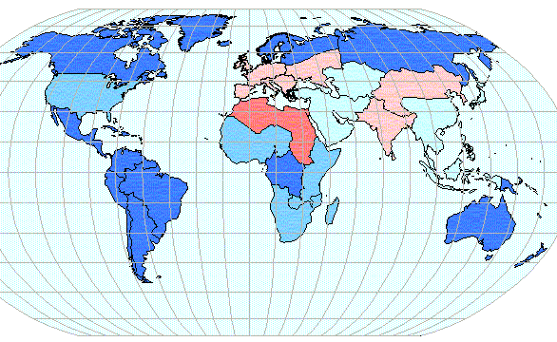
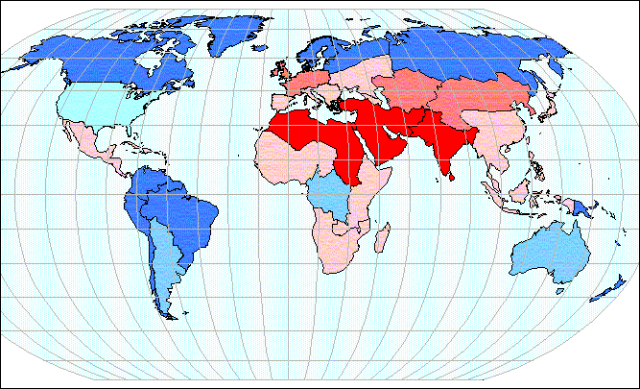
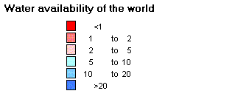
Water Resources
2010
1950
Thousand Cubic Meters per year per capita
Fig. 28. Water availability by natural-economic regions of the world: 1950 - 2025.

Slide 14
Minerals
The average automobile contains more than a ton of iron and steel, 240 lbs of aluminum, 50 lbs of carbon, 42 lbs of copper, 41 lbs of silicon, 22 lbs of zinc, and more than thirty other mineral commodities, including titanium, platinum, and gold

Slide 15
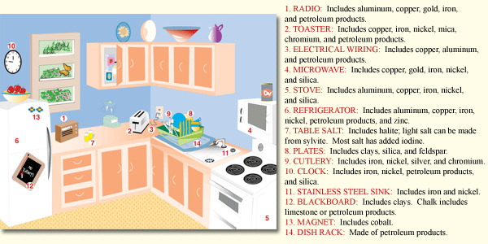
Minerals

Slide 16
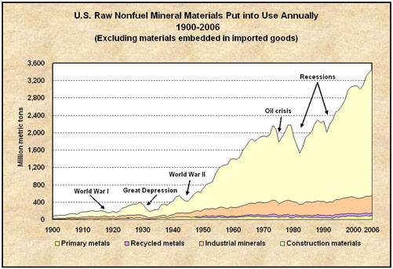
Minerals

Slide 17
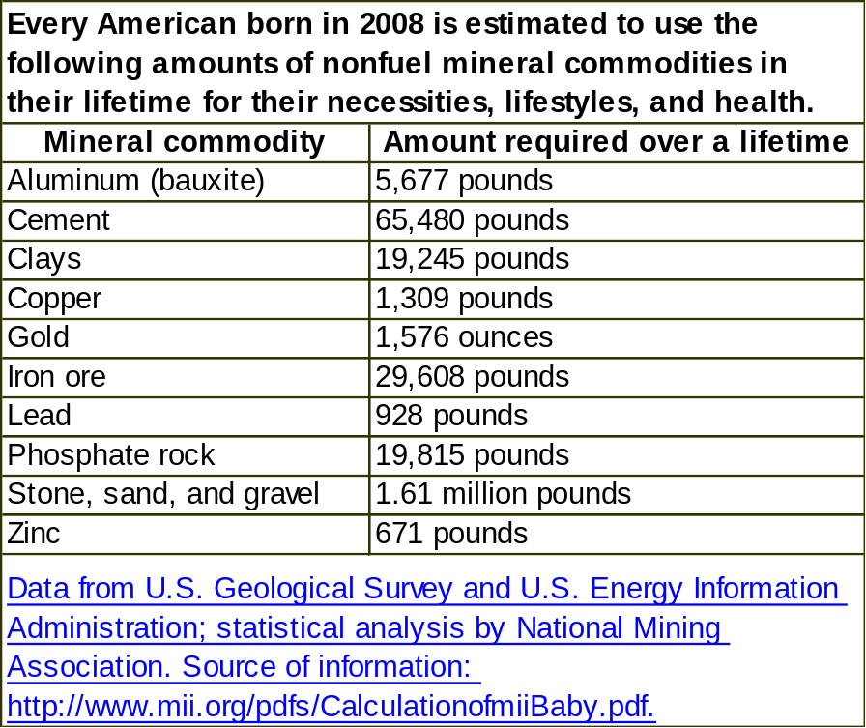
Minerals

Slide 18
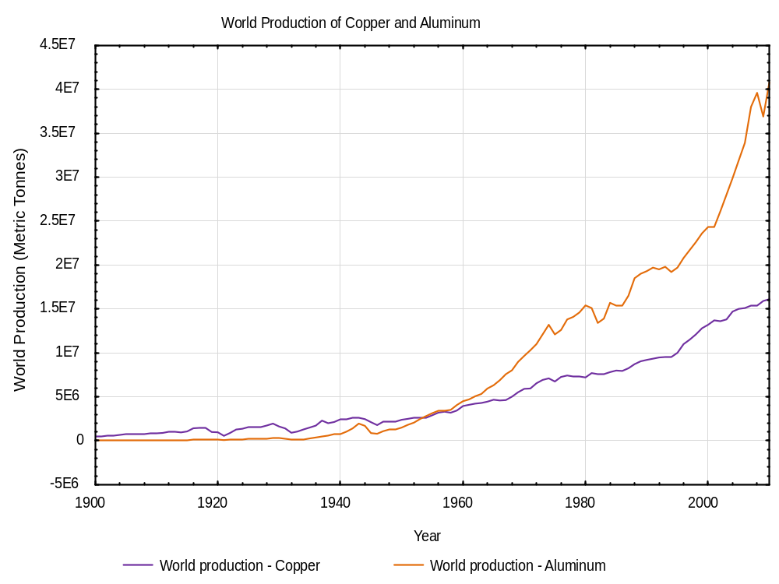
Copper and Aluminum

Slide 19
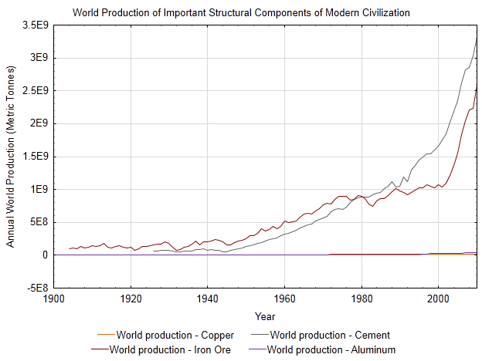
Cement, Iron, Copper and Aluminum

Slide 20
Tragedy of the Commons
An essay written by Garrett Hardin in 1968
Primarily about population increase, but our focus will be on understanding the commons, in general.

Slide 21
Tragedy of the Commons
Go to the document Tragedy of the Commons and discuss highlighted issues.

Slide 22
Management Principle
Manage the “commons,” either through educating everyone and creating forms of self-regulation and peer pressure, or through an official regulating mechanism, ideally designed by participants.

Slide 23
Beyond the Tragedy of the Commons
Elinor Ostrom
http://www.youtube.com/watch?v=ByXM47Ri1Kc
http://www.youtube.com/watch?v=E5ZPGeF2ics&feature=related
  Time 37:50-52:10

Slide 24
Sources
USGS Minerals Website.
  http://minerals.usgs.gov/ds/2005/140/
  http://minerals.usgs.gov/granted.html

